Slide 1

EDA Case Study
Group 10
Christina Faith, Nick Gobejishvili, Weiyi Lu

Slide 2
GitHub Repo
https://github.com/ng3339-prog/bootcamp_EDA

Slide 3
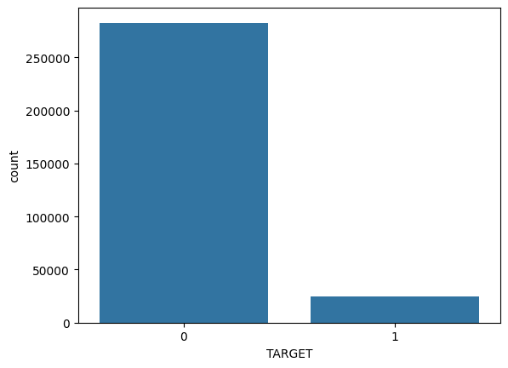
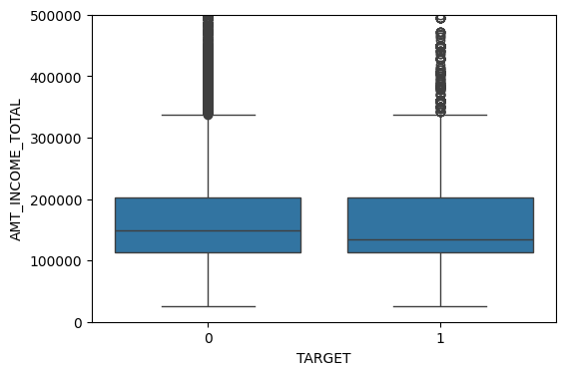
Part 1: Analysis of the Application Data
TOP GRAPH: Default v. Non-Default Distribution
Approximately 8% of customers experienced payment difficulties, and approximately 92% of customers made timely repayments.
This establishes the overall baseline risk in the lending portfolio.All later analyses compare borrower groups relative to this benchmark
BOTTOM GRAPH: Income and Default Risk
Income levels are similar between defaulters and non‑defaulters.
This suggests income alone is not a strong indicator of repayment difficulty.
Lenders must consider stability and behavioral variables beyond earnings level.

Slide 4
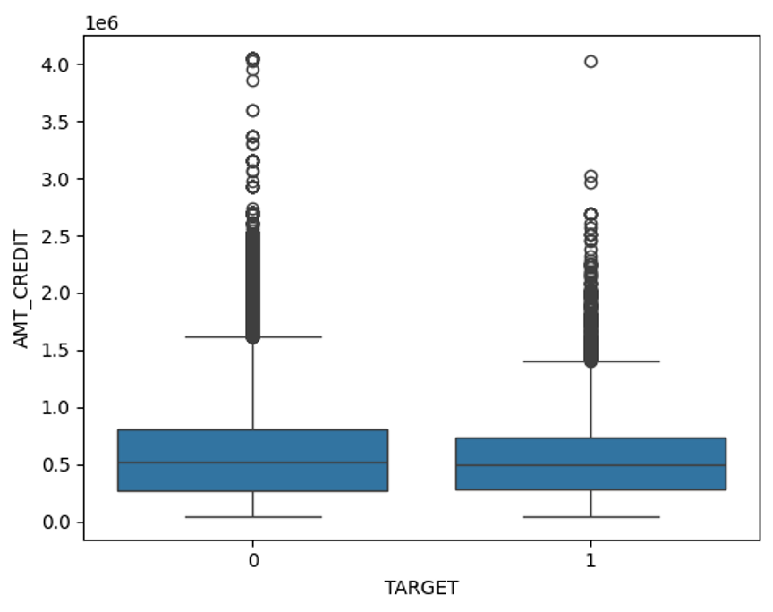
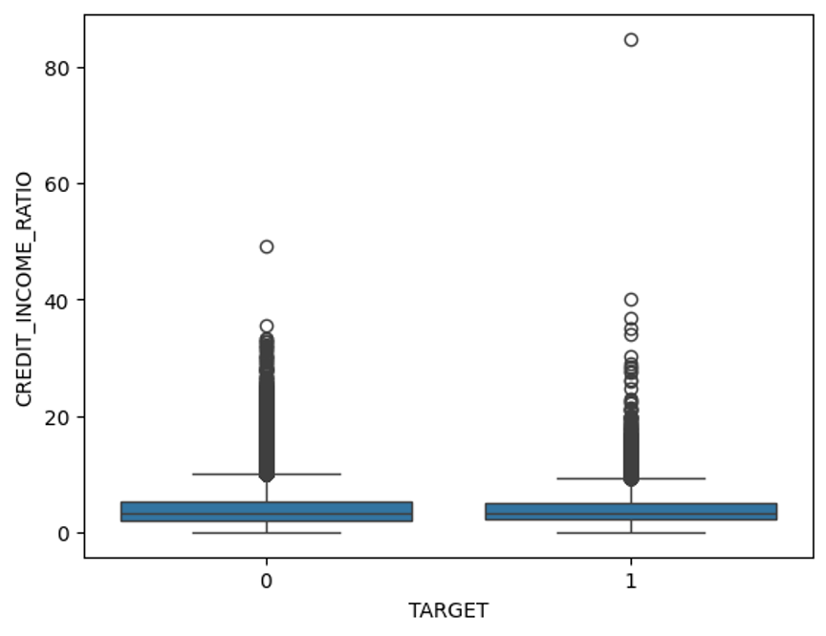
Credit-to-Income Ratio
This graph evaluates affordability by comparing requested credit relative to income.
Limited separation between groups suggests affordability alone is not the main driver.
Risk assessment requires demographic and behavioral indicators.
Loan Size and Default Risk
Loan amounts do not differ significantly across groups.
Loan size alone does not drive repayment difficulty.
Amount variables alone do not explain default risk.
This indicates approval decisions should rely more on borrower characteristics than loan size.

Slide 5
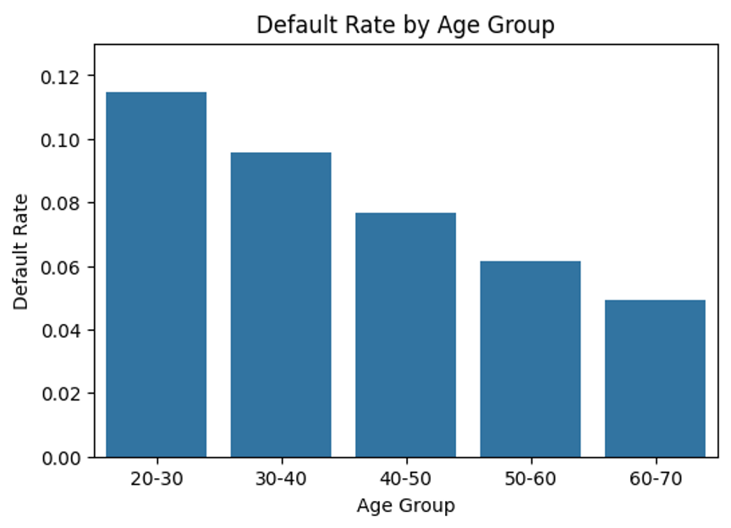
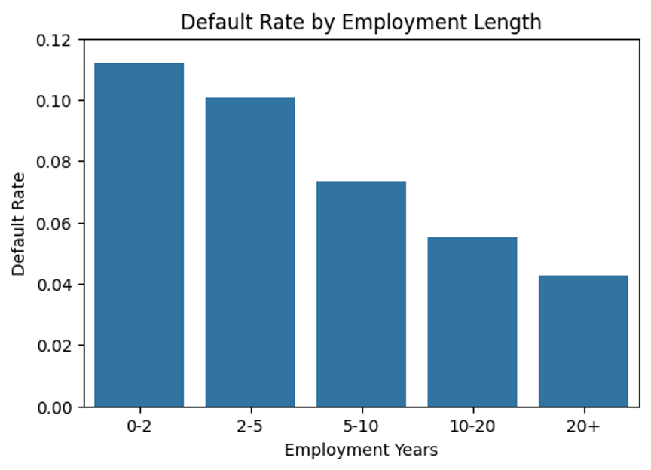
Default Rate by…
Age Group
Younger applicants show significantly higher default rates.
Default risk steadily decreases with age.
Age reflects financial maturity and becomes a strong segmentation variable for lending decisions.
Employment
Applicants with less than 2 years employment show ~11.2% default versus ~4.26% for 20+ years.
Employment stability strongly predicts repayment behavior.
This supports reducing exposure or tightening approval for unstable employment profiles.

Slide 6
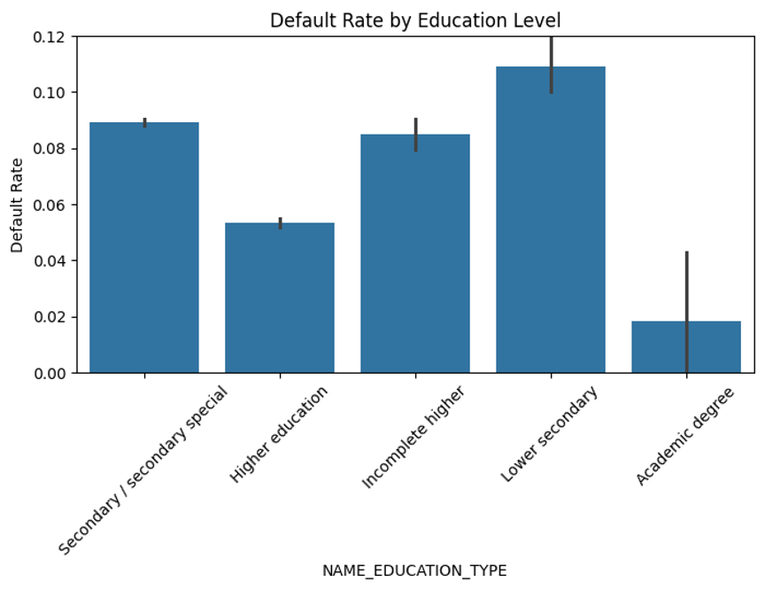
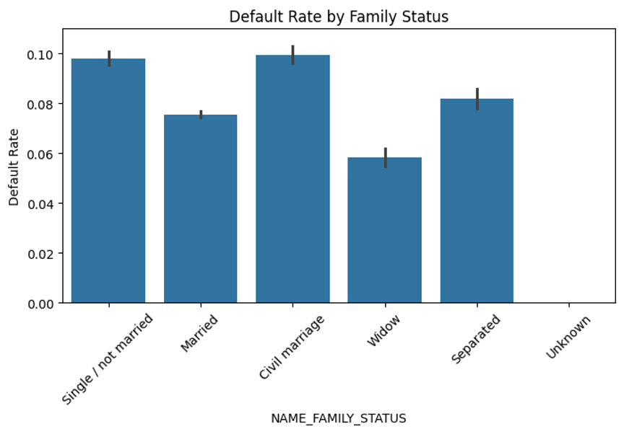
Default Rate by…
Education Level
Lower education groups have significantly higher default rates (~10.9%).
Academic degree holders show extremely low default (~1.8%).
Education captures long‑term financial resilience and repayment capability.
Family Status
Single and civil‑marriage applicants show higher default risk.
Married and widowed applicants demonstrate stronger repayment behavior.
Household stability appears linked to financial responsibility.

Slide 7
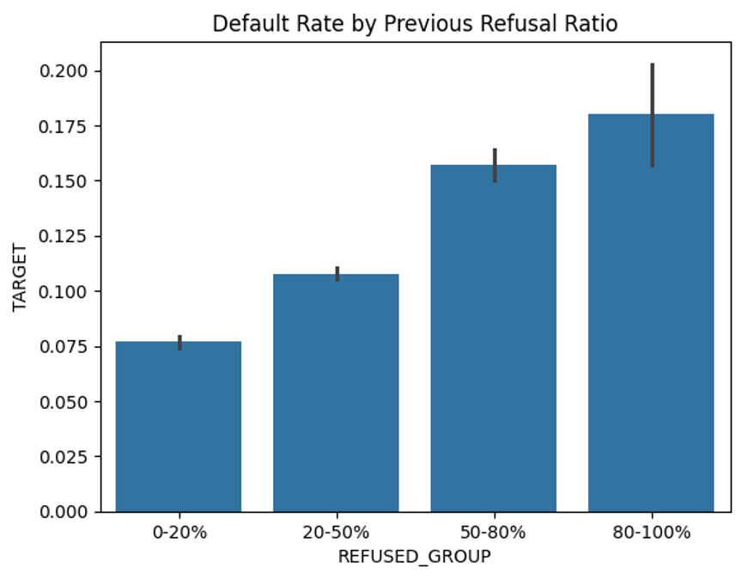
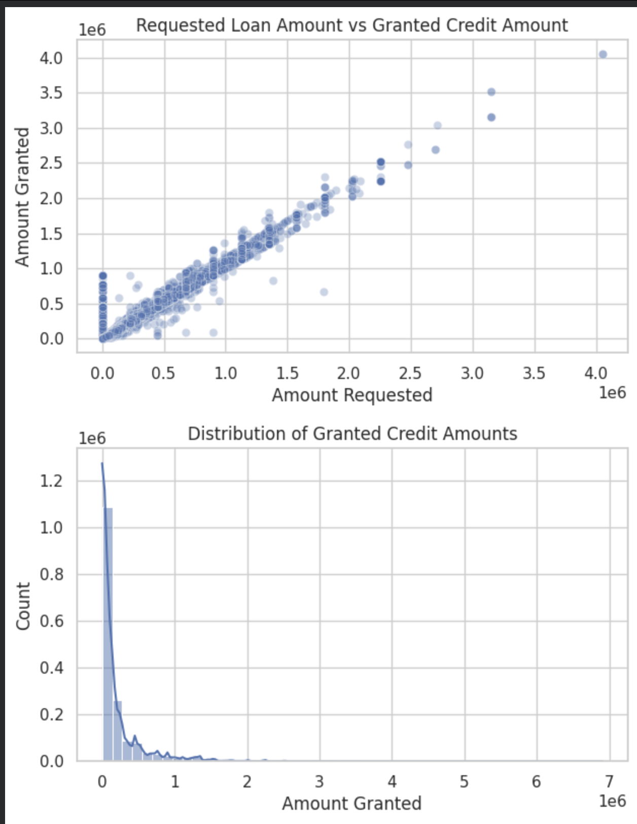
Part 2: Previous Applications – Behavioral Risk Signals
TOP GRAPH: Default Rate by Previous Refusal
Default risk increases monotonically as prior refusal ratio rises.
Clients with high refusal history approach ~18% default.
Past rejection behavior is one of the strongest predictors of future repayment difficulty.
BOTTOM GRAPH: Loan Application by Day of Week
Application volume remains relatively stable across weekdays.
Lower activity on weekends may reflect operational or customer behavior patterns.
Timing itself does not indicate risk but informs operational lending workflows.
Notes:
Approving loans should prioritize financial stability indicators rather than requested loan amount. Applicants with unstable employment or high refusal history may require: - Smaller loan amounts - Higher interest rates - Additional verification
Stable applicants should be approved efficiently to avoid loss of profitable customers.
Main Findings from EDA
Default risk is primarily driven by borrower stability, not loan size or income level. Strong predictors of default include: - Short employment history - Younger age - Lower education level - Unstable income sources
Behavioral history (previous refusals) provides the strongest signal of repayment difficulty.

Slide 8
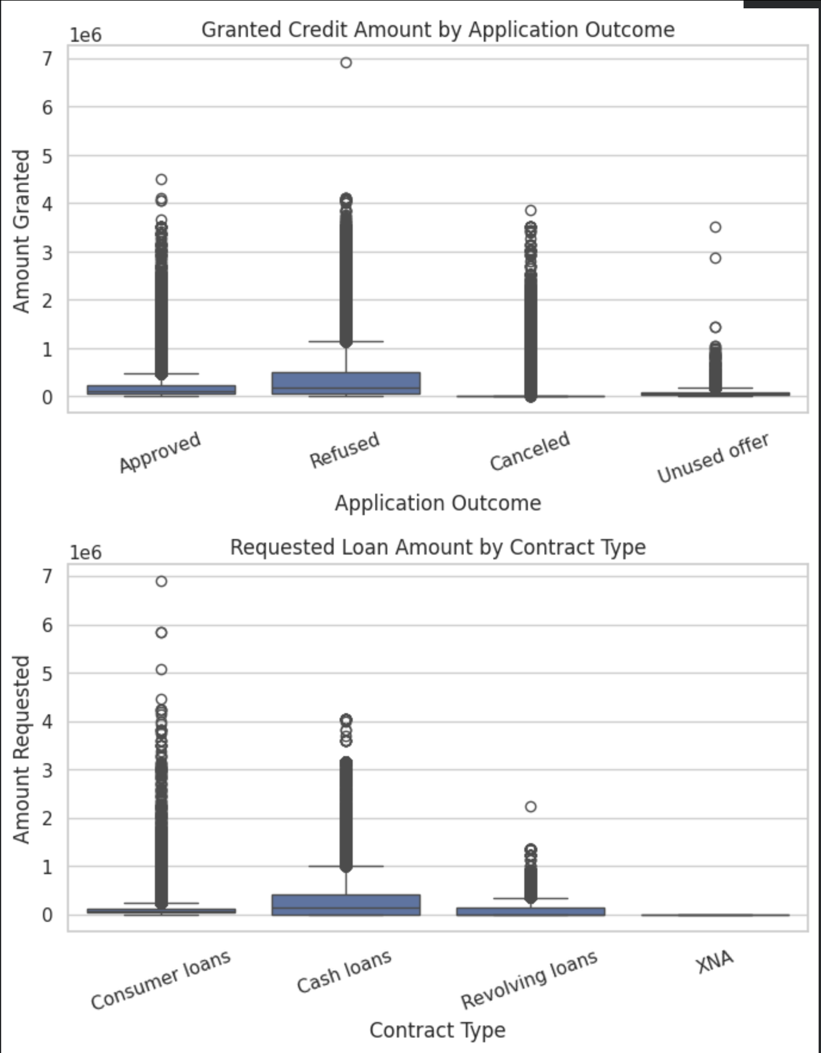
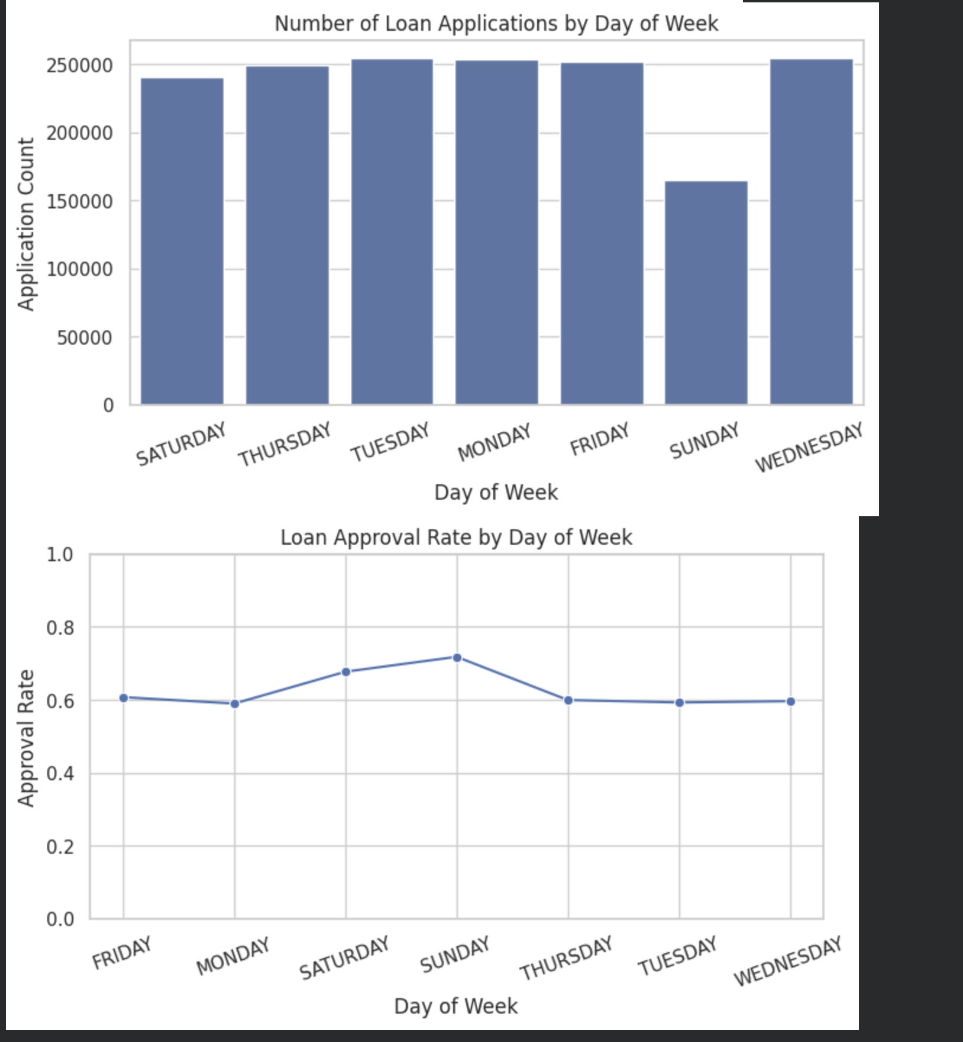
Requested v. Granted Credit
A strong positive relationship exists between requested and granted credit.
Lenders generally scale approvals proportionally to requests.
Credit adjustments likely reflect internal risk assessment processes.
Loan Approval Rate by Day
Approved loans tend to cluster at moderate credit levels.
Refused applications include many higher requested amounts.
This indicates loan size interacts with perceived borrower risk.
Notes:
Overall, the analysis shows that loan default is less related to how much customers borrow and more related to financial and behavioral stability. Variables such as employment length, education, income stability, and especially previous refusal history emerge as the strongest predictors of repayment difficulty. These insights allow the company to reduce financial risk while still approving creditworthy applicants, supporting smarter and more balanced lending decisions.

Slide 9
Thank you

